Slide 1
Chapter 11
How to work with images, icons, and fonts

Slide 2
Objectives
Applied
Use HTML to include images on a web page and CSS to align and float images.
Use the HTML figure and figcaption elements to treat an image as a figure.
Use HTML to create an image map that can be used to link to more than one web page.
Use the HTML img or picture elements to provide images for varying viewport sizes.
Use SVG files to provide graphics for varying viewport sizes.
Use the CSS @font-face selector, Google Web Fonts, or Adobe Web Fonts to embed fonts in a web page.

Slide 3
Objectives (continued)
Knowledge
Describe the proper use of the img element and its related CSS, including the accessibility guidelines.
Describe the use of the figure and figcaption elements for working with images.
Describe the use of image rollovers and image maps.
Describe the use of the picture and source elements for working with images.
Describe the use of the svg element and Scalable Vector Graphics.
Describe the use of image editors and tools for creating favicons.
In general terms, describe how the CSS @font-face selector works.
In general terms, describe the use of Google and Adobe Web Fonts.

Slide 4
Image types
JPEG
GIF
PNG
WebP
AVIF

Slide 5
Attributes of the <img> tag
src
alt
height
width
CSS properties for sizing an image
height
width

Slide 6
The HTML and CSS for two images
The HTML
<p><img src="images/students.jpg"
alt="teacher and students"
height="300" width="400">&nbsp;&nbsp;
<img id="small" src="images/students.jpg"
alt="teacher and students"></p>
The CSS for resizing the second image
#small {
height: 150px;
width: 200px; }

Slide 7

The original and resized images in a web browser

Slide 8
Accessibility guidelines
For images with useful content, always code an alt attribute that describes the content.
For images that are used for decoration, code the alt attribute as an empty string.

Slide 9
The property for aligning images vertically
vertical-align
Common keywords for this property
bottom
middle
top
text-bottom
text-top

Slide 10
The HTML and CSS for three images
The HTML
<h2>We want to hear from you</h2>
<p><img src="images/computer.gif" alt="web address">
<strong>Web:</strong> www.murach.com</p>
<p><img src="images/telephone.gif" alt="phone">
<strong>Phone:</strong> 1-800-221-5528</p>
<p><img src="images/email.gif" alt="email">
<strong>Email:</strong> murachbooks@murach.com</p>
The CSS that aligns the images
img {
vertical-align: middle;
margin-right: 10px; }

Slide 11


The images in a web browser
Before they’re aligned
After they’re aligned

Slide 12
The properties for floating images
float
clear

Slide 13
Some of the HTML for a web page
<img src="images/students.jpg"
alt="teacher and students">
<ul>
<li>in college and university MIS programs that focus
on providing students with practical, real-world
experience</li>
<li>by technical institutes and community colleges
that focus on the skills that employers are
looking for</li>
<li>...</li>
</ul>
<p id="last">...</p>
CSS for floating an image and clearing the last paragraph
img {
float: left;
margin-top: 15px;
margin-bottom: 10px; }
#last { clear: left; }

Slide 14

The HTML in a web browser

Slide 15
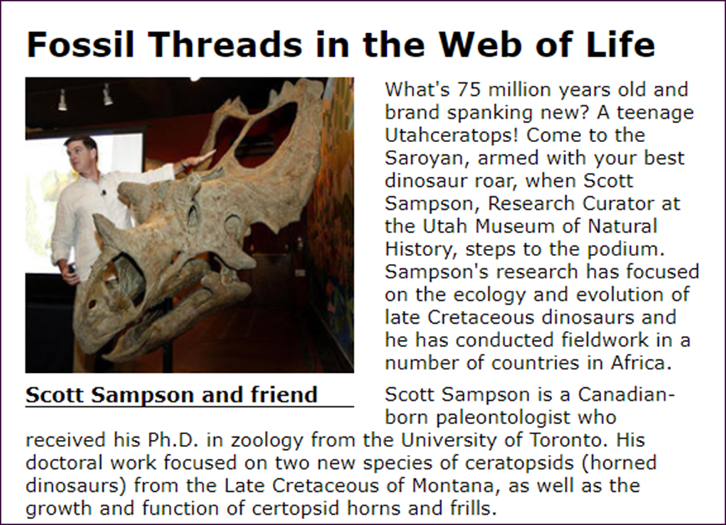
A web page with figure and figcaption elements

Slide 16
The HTML for the figure and figcaption elements
<article>
<h1>Fossil Threads in the Web of Life</h1>
<figure>
<img src="images/sampson_dinosaur.jpg"
alt="Scott Sampson">
<figcaption>Scott Sampson and friend</figcaption>
</figure>
<p>...</p>
</article>
The CSS for the figure and figcaption elements
figure {
float: left;
margin-right: 1.5em; }
figcaption {
display: block;
font-weight: bold;
padding-top: .25em;
margin-bottom: 1em;
border-bottom: 1px solid black; }

Slide 17
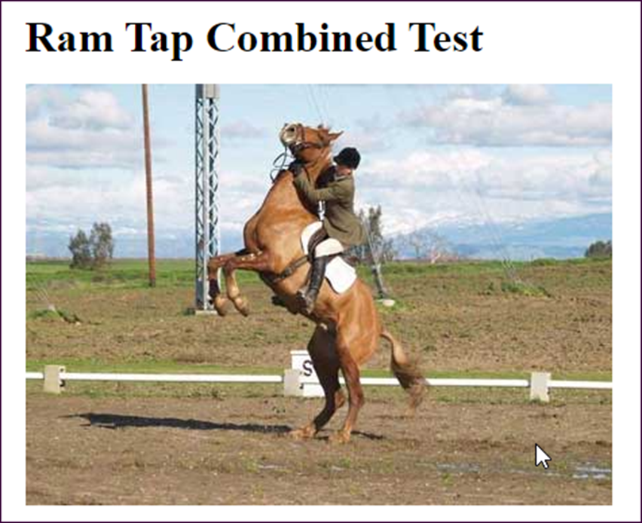
This image has been rolled over because the mouse is hovering over it

Slide 18
The HTML and CSS for an image rollover
The HTML
<body>
<h1>Ram Tap Combined Test</h1>
<p id="image1"></p>
</body>
The CSS
#image1 {
background-image: url("h1.jpg");
width: 434px;
height: 312px;
}
#image1:hover {
background-image: url("h2.jpg");
}

Slide 19

An image in a web browser with hotspots created by an image map

Slide 20
The HTML for the image and image map
<img src="images/web_books.jpg"
alt="PHP/MySQL and JavaScript/jQuery books"
usemap="#books">
<map name="books">
<area href="php_mysql.html"
shape="poly"
alt="PHP/MySQL book"
title="PHP/MySQL"
coords="0,30,115,0,133,67,109,156,39,174">
<area href="javascript_jquery.html"
shape="poly"
alt="JavaScript/jQuery book"
title="JavaScript/jQuery"
coords="145,21,261,52,222,195,107,165">
</map>

Slide 21
Attributes of the img element for adding multiple image resources
srcset
sizes
An img element that displays different image sizes based on viewport size
<img src="images/mountains_medium.png" alt="mountains"
srcset="images/mountains_large.png 800w,
images/mountains_medium.png 600w,
images/mountains_small.png 400w"
sizes="(min-width: 1200px) 800px,
(min-width: 800px) 600px, 100vw">

Slide 22
Elements for adding multiple image resources
picture
source
img
Attributes of the source element
media
srcset
type

Slide 23
A picture element that displays different images based on viewport size
<picture>
<source media="(min-width: 960px)"
srcset="images/mountains_far.png">
<source media="(min-width: 768px)"
srcset="images/mountains_mid.png">
<source media="(min-width: 460px)"
srcset="images/mountains_close.png">
<img src="images/mountains_mid.png" alt="">
</picture>

Slide 24
A picture element that displays an image in an alternative format
<picture>
<source type="image.avif"
srcset="images/mountains_small.avif">
<img src="images/mountains_small.png" alt="">
</picture>

Slide 25

The Murach logo as an SVG element
<svg viewBox="0 0 247.83 76.96">
<rect class="cls-1" width="80" height="76.96"/>
<path class="cls-2"
d="M28.19,18.36H18.13s3.29.09,3.29,4.33V52l10.53-
3.33V22.47C31.95,19.88,30.58,18.37,28.19,18.36Z"/>
<path class="cls-2"
d="M40.33,21.9H30.26s3.29.08,3.29,4.32V55.52l10.53-
3.33V26C44.09,23.43,42.72,21.91,40.33,21.9Z"/>
<path class="cls-2"
d="M52.42,25.53H42.36s3.29.08,3.29,4.32V59.14l10.53-
3.33V29.64C56.18,27.05,54.81,25.54,52.42,25.53Z"/>
</svg>
The logo

Slide 26
The benefits of SVG
SVG code loads faster than image files so your web pages will load faster and improve the user experience.
SVG images are scalable so they work well for Responsive Web Design.
SVG images are recognized by Google just as other images are so they won’t affect SEO.
Drawbacks of SVG
Without a background in graphics design, SVG images can be hard to create.
SVG isn’t suitable for complex images like photographs.

Slide 27
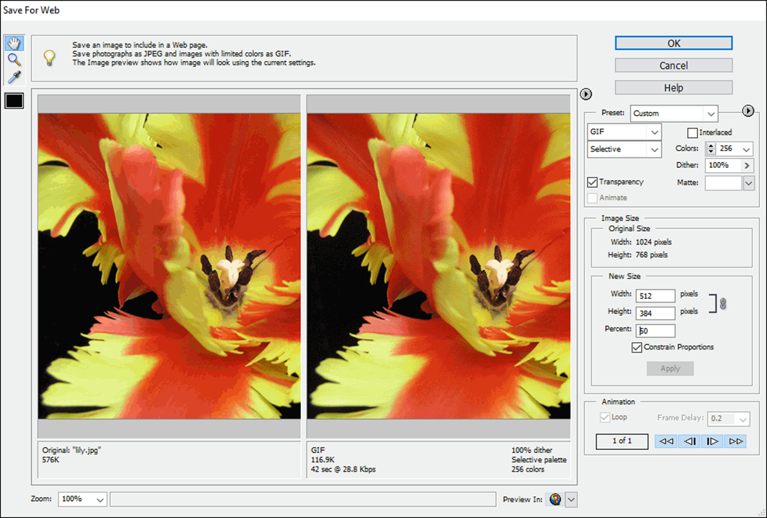
An image editor

Slide 28
Typical editing operations
Change the size, image type, or quality of an image.
Control the animation of an animated GIF file.
Save an image with transparency or a matte.
Get the coordinates for an image map.
Three popular image editors
Adobe Photoshop CC (the industry standard for graphic artists)
Adobe Photoshop Elements (an inexpensive editor)
GIMP (a free editor)

Slide 29

An image without transparency and with transparency and a matte

Slide 30
Creative Commons license conditions for images and icons
Attribution
Share Alike
Non-Commercial
No Derivative Works

Slide 31
Popular websites for images
www.freeimages.com
www.freefoto.com
www.openphoto.net
www.google.com/imghp
Popular websites for stock photos
www.istockphoto.com
www.gettyimages.com
A popular search engine for stock photos
www.everystockphoto.com

Slide 32
Popular websites for icons
https://fontawesome.io
www.glyphicons.com
www.glyphish.com
www.flaticon.com

Slide 33
How to include the Font Awesome library from a CDN
<script src=
"https://use.fontawesome.com/releases/v5.0.1/js/all.js">
</script>

Slide 34

HTML that uses 3 Font Awesome icons
<h2>We want to hear from you</h2>
<ul>
<li><i class="fas fa-globe fa-lg"></i> <strong>Web:</strong> www.murach.com</li>
<li><i class="fas fa-phone-square fa-lg"></i> <strong>Phone:</strong> 1-800-221-5528</li>
<li><i class="fas fa-envelope-square fa-lg"></i> <strong>Email:</strong> sales@murach.com</li>
</ul>
The icons in a web browser

Slide 35
Two of the tools for creating favicons
Axialis Icon Workshop
Photoshop plugin

Slide 36
A link element that adds a favicon to the browser tab
<link rel="shortcut icon" href="images/favicon.ico">

Slide 37

A heading that uses a font imported with CSS
The CSS for embedding a font
@font-face {
font-family: Murach;
src: url("HARNGTON.TTF"); }
The CSS for applying the font to an element
h1 {
font-family: Murach; }
The HTML for the element
<h1>Murach Books</h1>

Slide 38
Where to find the fonts on your computer
On a Windows system
C:\Windows\Fonts
On a Mac OS system
System\Library\Fonts
How to import a font
Copy the file for the font family into a folder for your website.
In the CSS for the page, code a style rule for the @font-face selector.
Use the font-family property to provide a name for the imported font family, and use the src property to locate the font file.

Slide 39

A heading that uses a Google Web Font
The link element that imports the font
<link href=
"https://fonts.googleapis.com/css2?family=Sorts+Mill+Goudy&display=swap"
rel="stylesheet">
The CSS for applying the font to an element
h1 { font-family: "Sorts Mill Goudy", serif; }
The HTML for the element
<h1>Murach Books</h1>

Slide 40

A heading that uses an Adobe Edge Web Font
The script element that imports the font
<script src="//use.edgefonts.net/alex-brush.js"></script>
The CSS that applies the font to an element
h1 { font-family: alex-brush, cursive; }
The HTML for the element
<h1>Murach Books</h1>

Slide 41
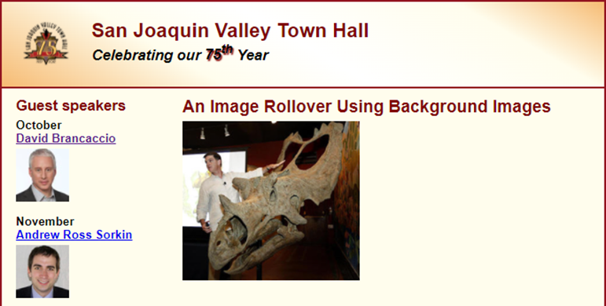
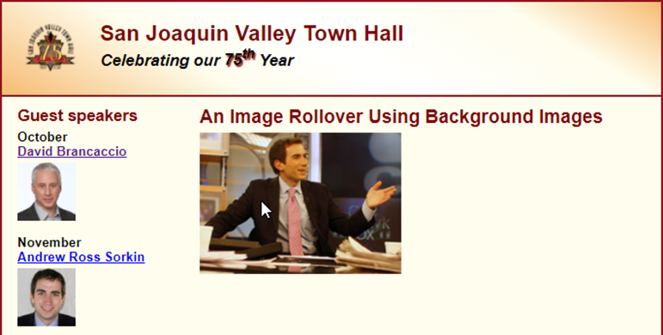
Short 11-1 Do an image rollover with CSS

